Slide 1
2016 Presidential Election Model
Updated Election Model Walkthrough & Discussion - Senior Meeting

Slide 2
The Problem
Create the Model
Context
Problem statement
The problem the Data Analytics team is trying to solve is to create a model that is simultaneously simple, flexible, and robust.
The model must be easily updated and able to incorporate new info.
Many interested parties have created overly complicated models to predict election outcomes.
These models are often overfitted and needlessly complicated, making comprehension difficult.
Create a simple, flexible, and robust model that is able to quickly incorporate new polling information and to provide answers to two pressing questions:
Which states should the campaign focus on?
Who will win the election?

Slide 3
Challenges Deep-Dive
Challenge 1
Challenge 2
Challenge 3
Create a simple, flexible, and robust model
Instead of utilizing a regression based model, the team worked to develop a machine learning model that is much simpler but just as robust.
Use the model to provide a “hit list” of swing states
The campaign needs a swing state “hit list” - a list of states in which to campaign.
Use the model to make regularly updated, state-by-state winner predictions
The model must be able to incorporate new polling data to make regularly updated winner predictions for each state

Slide 4
Solution
The team has developed a simple, flexible, and robust model, utilizing a k-means clustering model that categorizes states as either solidly Democratic, solidly Republican, or Swing. A simple modification of the model then allows us to make state-by-state winner predictions.
K-means Clustering

Slide 5
Recommendations
The model suggests that though Clinton is the predicted winner of the 2016 presidential election, her lead is tenuous (a net margin of only 8 electoral votes).
Therefore, it is the recommendation of the Data Analytics team that Clinton focus on shoring up her base in those Democratic states that are the most “at risk” of defecting to Trump.
We recommend that the Clinton campaign dedicate campaign resources to the states of Pennsylvania, Michigan, and Wisconsin - dedicating resources to our “hit list” of swing states only if time and resources allow.

Slide 6
Model Walkthrough
A k-means clustering technique

Slide 7
The Data
The data utilized in this model comes from FiveThirtyEight’s page on kaggle.com. The original file is a .csv file containing 27 fields. There were many superfluous columns in this dataset that we removed.
The final data set included the following fields:
state - the state from which the poll was taken (the value "U.S." signifies a national poll).
enddate - the date on which the poll ended.
pollster - the organization that conducted the poll.
rawpoll_clinton - the raw percentage of respondents polled who plan on voting for Clinton.
rawpoll_trump - the raw percentage of respondents polled who plan on voting for Trump.

Slide 8
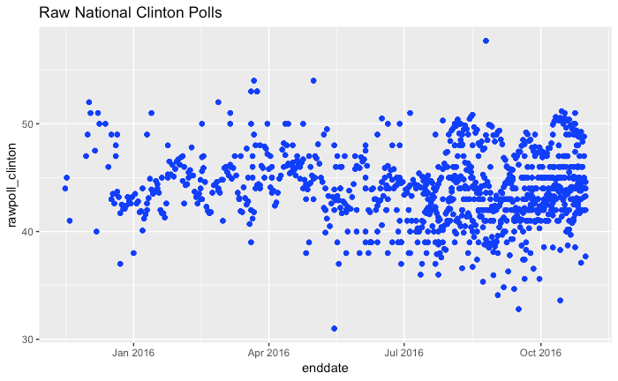
Clinton’s Raw Polling Data

Slide 9
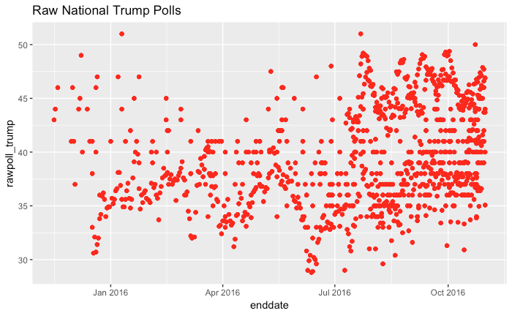
Trump’s Raw Polling Data

Slide 10
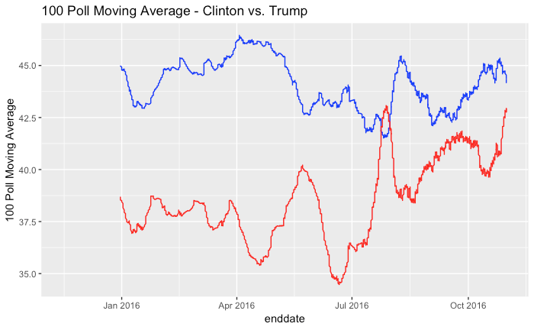
100 Poll Moving Average

Slide 11
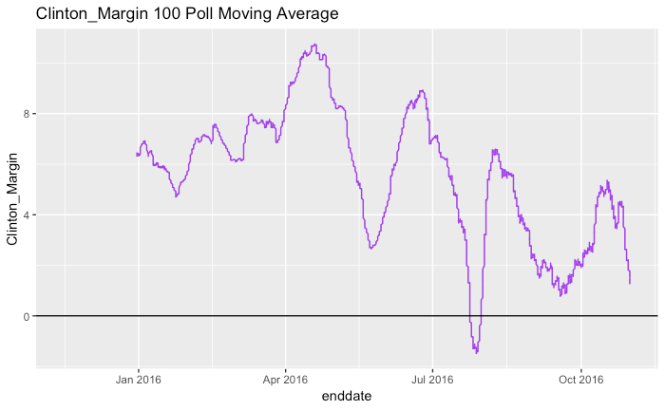
Clinton’s 100 Poll Margin Moving Average

Slide 12
K-Means Clustering
K-means clustering attempts to divide data into k number of discrete groups and is highly effective at uncovering underlying data patterns.
The k-means clustering algorithm works by:
Splitting data into k number of clusters by initially randomly assigning a category or class to each data point.
Finding the k number of Centroids - i.e. the points of central tendency (or mean value) for each category or class of data points.
Reassigning the points according to their nearest centroid by calculating their Euclidean distances.
Recalculating the centroids.
Repeating steps 3 and 4 until the centroids no longer change and all the data points have been successfully classified.

Slide 13
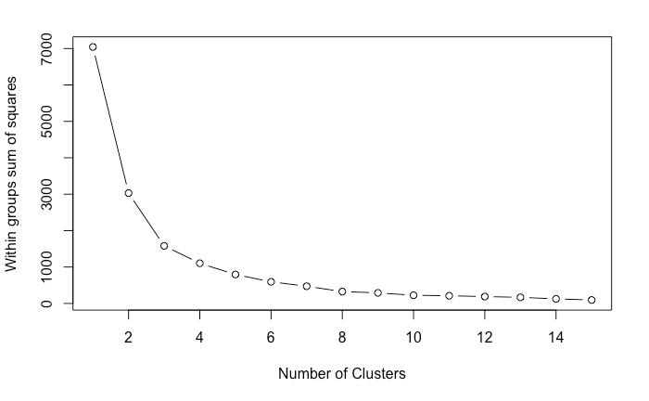
Scree Plot

Slide 14
Model Results (k = 3)
Solidly Democratic States (Electoral Votes)
California (55)
Colorado (9)
Connecticut (7)
Delaware (3)
District of Columbia (3)
Hawaii (4)
Illinois (20)
Maine (4)
Maryland (10)
Massachusetts (11)
Michigan (16)
Minnesota (10)
New Hampshire (4)
New Jersey (14)
New Mexico (5)
New York (29)
Oregon (7)
Pennsylvania (20)
Rhode Island (4)
Vermont (3)
Virginia (13)
Washington (12)
Wisconsin (10)
Total Electoral Votes: 273
Swing States (Electoral Votes)
Alaska (3)
Arizona (11)
Florida (29)
Georgia (16)
Indiana (11)
Iowa (6)
Kansas (6)
Missouri (10)
Nevada (6)
North Carolina (15)
Ohio (18)
South Carolina (9)
Texas (38)
Utah (6)
Total Electoral Votes: 184
Solidly Republican States (Electoral Votes)
Alabama (9)
Arkansas (6)
Idaho (4)
Kentucky (8)
Louisiana (8)
Mississippi (6)
Montana (3)
Nebraska (5)
North Dakota (3)
Oklahoma (7)
South Dakota (3)
Tennessee (11)
West Virginia (5)
Wyoming (3)
Total Electoral Votes: 81

Slide 15
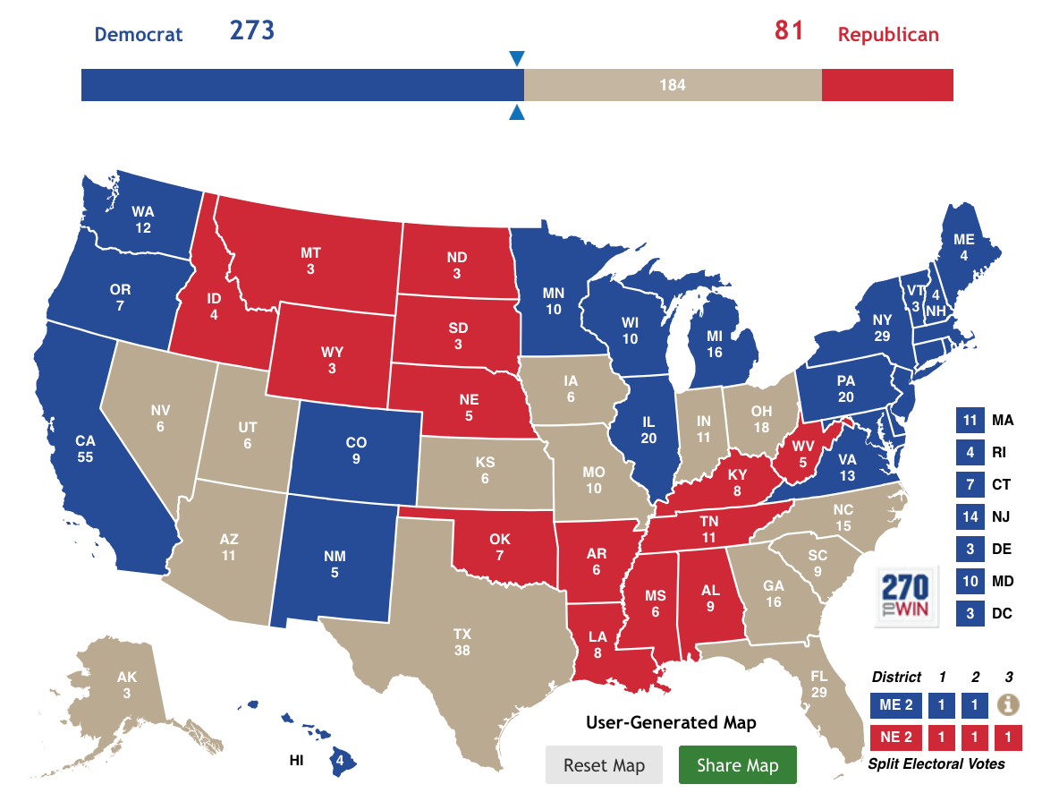
Model Results (k = 3) - Mapped

Slide 16
Model Results (k = 2)
Democratic States (Electoral Votes)
California (55)
Colorado (9)
Connecticut (7)
Delaware (3)
District of Columbia (3)
Hawaii (4)
Illinois (20)
Maine (4)
Maryland (10)
Massachusetts (11)
Michigan (16)
Minnesota (10)
New Hampshire (4)
New Jersey (14)
New Mexico (5)
New York (29)
Oregon (7)
Pennsylvania (20)
Rhode Island (4)
Vermont (3)
Virginia (13)
Washington (12)
Wisconsin (10)
Total Electoral Votes: 273
Republican States (Electoral Votes)
Alabama (9)
Alaska (3)
Arizona (11)
Arkansas (6)
Florida (29)
Georgia (16)
Idaho (4)
Indiana (11)
Iowa (6)
Kansas (6)
Kentucky (8)
Louisiana (8)
Mississippi (6)
Missouri (10)
Montana (3)
Nebraska (5)
Nevada (6)
North Carolina (15)
North Dakota (3)
Ohio (18)
Oklahoma (7)
South Carolina (9)
South Dakota (3)
Tennessee (11)
Texas (38)
Utah (6)
West Virginia (5)
Wyoming (3)
Total Electoral Votes: 265

Slide 17
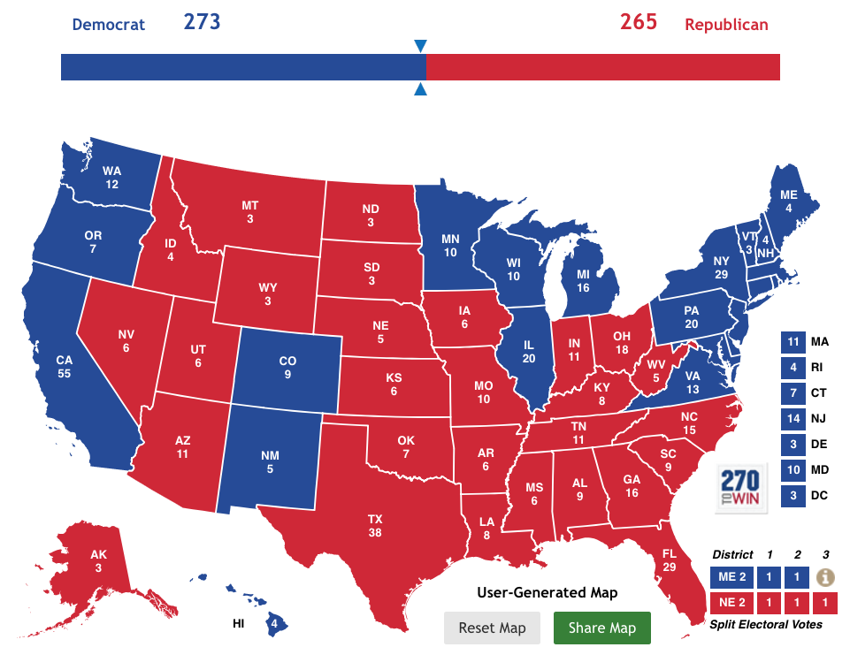
Model Results (k = 2) - Mapped

Slide 18
Grand Strategy
Option 1 - Defensive/Conservative Strategy: Clinton should shore up her base in those states most likely to vote for her. This may not lead to an electoral blow-out, but it would be the strategy most likely to lead to victory.
If Clinton were to adopt this strategy it would be important to know which states in her coalition are most likely to defect to Trump. She should then devote campaign resources to these “at risk” states in order to shore up her likelihood of reaching 270 electoral votes.

Slide 19
“At Risk” States
If we look only at those states with an unrounded mean cluster group score of 1.3 or higher, and order the list from greatest electoral votes to least, we get the following "at risk" list:
Pennsylvania (20)
Michigan (16)
Wisconsin (10)
Colorado (9)
New Hampshire (4)
Maine (4)
Total Electoral Votes: 63

Slide 20
Grand Strategy
Option 2 - Offensive/Risky Strategy: Clinton should make a play for the swing states, dedicating resources to states with thee greatest number of electoral votes. Though Clinton may lose some blue states the result may be a larger overall electoral vote total.
This strategy seeks to maximize electoral votes at greater electoral risk. making a push into large swing states could result in a larger electoral vote margin, and may therefore give Clinton greater political capital once in office. In other words, the goal is not just to win but to win big.

Slide 21
“Hit List” States
If the senior campaign team chooses this strategy it makes the most sense to campaign in those swing states with the largest number of electoral votes. Once again, these states include:
Florida (29)
Ohio (18)
North Carolina (15)
Arizona (11)
Iowa (6)
Nevada (6)
Total Electoral Votes: 63

Slide 22
Our Recommendation
If Clinton were to lose all of her "at risk" states but gained all of the swing states, the result would be a net gain of 22 electoral votes, bringing her total up to 295. Perhaps this would change the perceptions of Congress, and provide her with additional political capital once in office.
However, if our goal is to help the campaign attain the requisite number of electoral votes with the highest probability of success, then the only strategy that does both is the conservative strategy.
Therefore, our recommendation is that the Clinton campaign devote resources to shoring up her "at risk" states and to adopt a more defensive strategy.

Slide 23
Results & Accuracy - Swing States (k = 3)
Let us define a swing state as a state that had a +/-5% Clinton margin. Below is a list of these states, as well as Clinton's margin in each state (* indicates that the state was on the original list of swing states):
Michigan (-0.22%)
New Hampshire (+0.37%)
Pennsylvania (-0.72%)
Wisconsin (-0.76%)
Florida (-1.20%)*
Minnesota (+1.52%)
Nevada (+2.42%)*
Maine (+2.96%)
Arizona (-3.55%)*
North Carolina (-3.66%)*
Colorado (+4.91%)
Overall Accuracy: ~36.4%

Slide 24
Results & Accuracy - Democratic States (k = 3)
Below is a list of states that ended up being solid Clinton wins, which we will define as a margin greater than +5% (* indicates that the state was on the original list of solidly Clinton states):
District of Columbia (+86.78%)*
Hawaii (+32.18%)*
California (+30.11%)*
Massachusetts (+27.20%)*
Maryland (+26.42%)*
Vermont (+26.41%)*
New York (+22.49%)*
Washington (+15.71%)*
Rhode Island (+15.51%)*
New Jersey (+14.10%)*
Connecticut (+13.64%)*
Delaware (+11.37%)*
Oregon (+10.98%)*
New Mexico (+8.21%)*
Virginia (+5.32%)*
Overall Accuracy: 100%

Slide 25
Results & Accuracy - Republican States (k = 3)
Below is a list of states that ended up being solid Trump wins, which we will define as a margin less than -5% (* indicates that the state was on the original list of solidly Trump states):
Wyoming (-46.30%)*
West Virginia (-42.07%)*
Oklahoma (-37.08%)*
North Dakota (-35.73%)*
Idaho (-31.77%)*
Kentucky (-29.84%)*
South Dakota (-29.79%)*
Alabama (-27.73%)*
Arkansas (-26.92%)*
Tennessee (-26.01%)*
Nebraska (-25.05%)*
Kansas (-20.60%)
Montana (-20.42%)*
Louisiana (-19.64%)*
Indiana (-19.17%)
Missouri (-18.64%)
Utah (-18.08%)
Mississippi (-17.83%)*
Alaska (-14.73%)
South Carolina (-14.27%)
Iowa (-9.41%)
Texas (-8.99%)
Ohio (-8.13%)
Georgia (-5.13%)
Overall Accuracy: ~58.3%

Slide 26
Results & Accuracy (k = 2)
In the end, we accurately predicted the winner of every state except 4 - Michigan, Nevada, Pennsylvania, and Wisconsin - a ~92% accuracy rate. If we compare this a random coin toss, we handily beat this baseline assumption of 50%.
Note: of those four states we got wrong, three were on our "at risk" list of states: Pennsylvania, Michigan, and Wisconsin. As part of our conservative strategy recommendation, we urged the Clinton campaign to dedicate resources to these three states in order to shore up support and to prevent defection - especially given her tenuous lead in the electoral college.

Slide 27
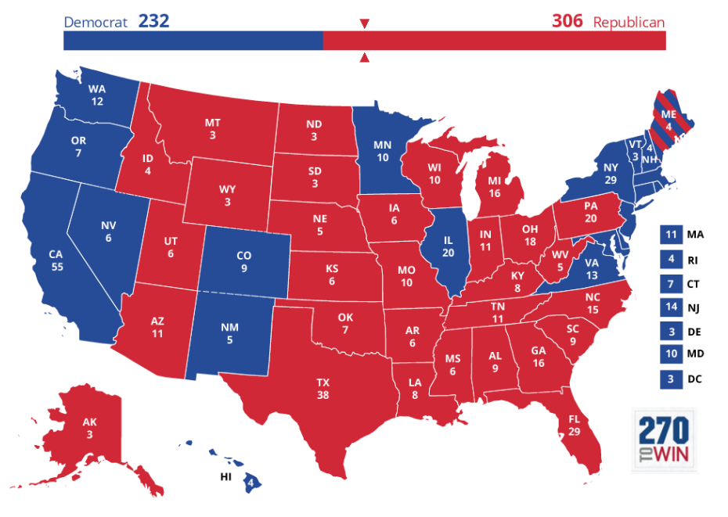
Results & Accuracy (k = 2) - Mapped
Predicted
Actual

Slide 28
Areas for Improvement/Further Exploration
One major limitation to the data is that the data is exclusive to 2016, meaning that we did not have previous election year data to work with. This limitation became abundantly clear early on as we attempted to create a logistic regression formula to predict the winner of each state based on Clinton and Trump’s raw polling data.
Some areas for further exploration include the following:
Testing FiveThirtyEight’s pollster grading system by incorporating the adjpoll_clinton and adjpoll_trump fields into a modified version of the model.
Testing whether weighting more recent polls greater than older polls will improve the accuracy of the model.
Testing whether weighting polling data by respondent size improves the accuracy of the model.

